Slide 1
EE336: Course Project Topic: Weather Forecasting using
Stochastic Models
Checked By : Ribhu Sir
Submitted By : Rajnandni Parmar(210108037)

Slide 2

Geographical Location
City: Basel, Switzerland
latitude : 47.5596
longitude: 7.5886
Elevation in meters:260

Slide 3
EDA: Exploratory Data Analysis
Data: From 1 Jan 2000 to 1 Jan 2010
Data taken from Kaggle
Statistics:
 | Temp_mean | Temp_min | Temp_max
AVG | 11.0228 | 6.989135 | 15.53678
MAX | 29 | 20.8 | 38.6
MIN | -9.3 | -16 | -5.7

Slide 4
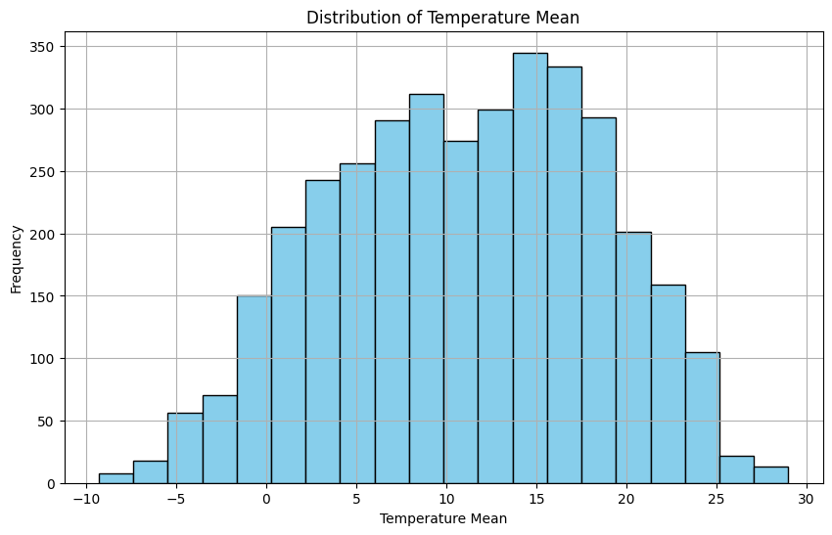
# Histogram of 'BASEL_temp_mean'

Slide 5
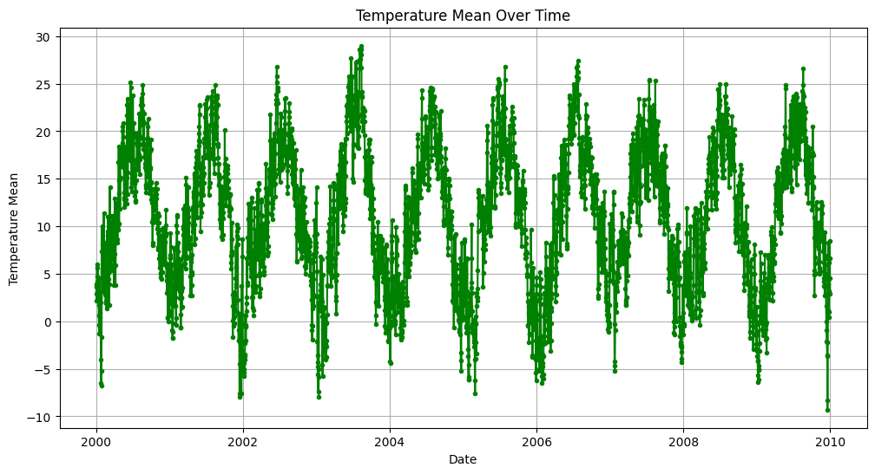
# Line plot of 'BASEL_temp_mean' over time

Slide 6
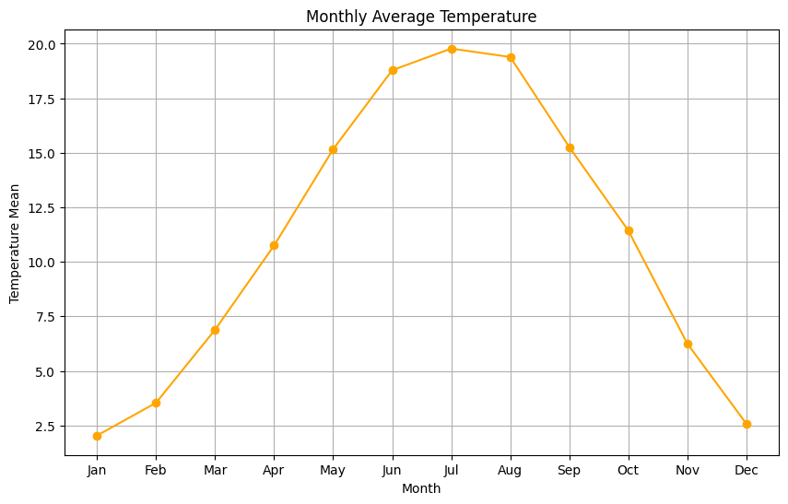
# Monthly average temperature

Slide 7
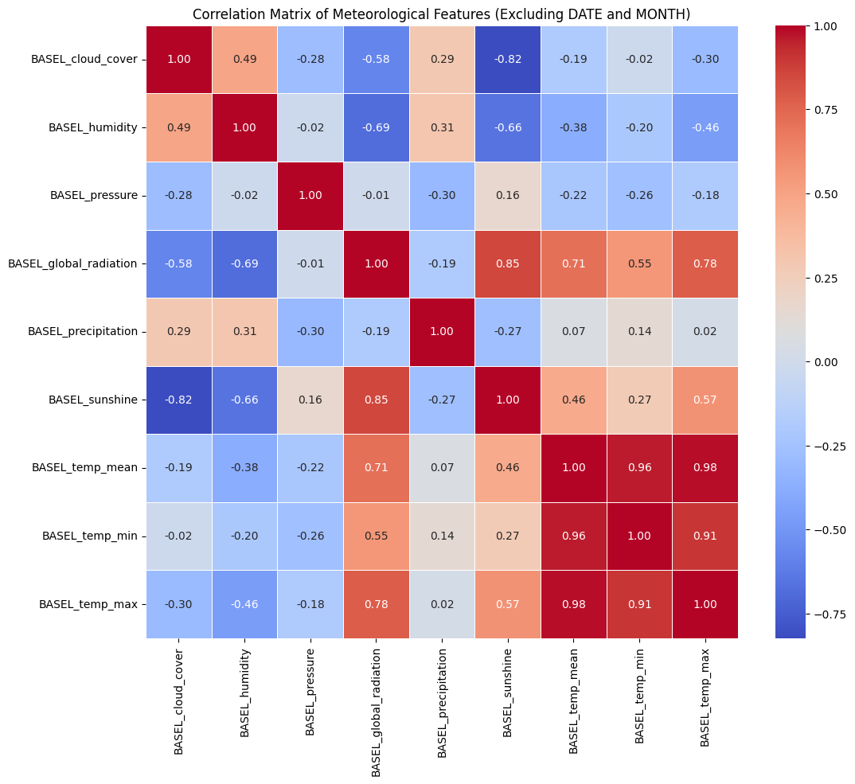

Slide 8
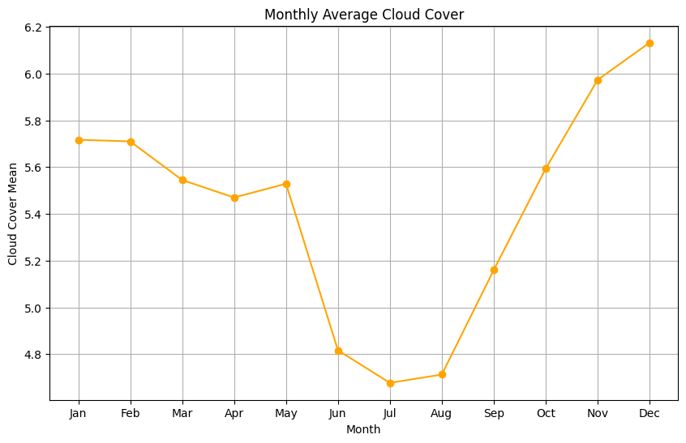
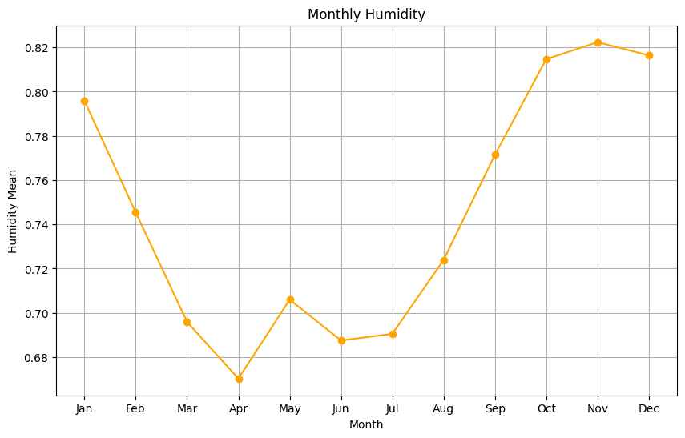
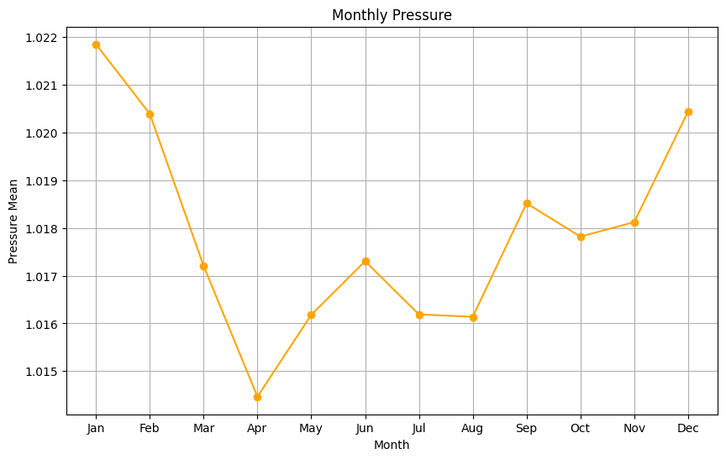

Slide 9
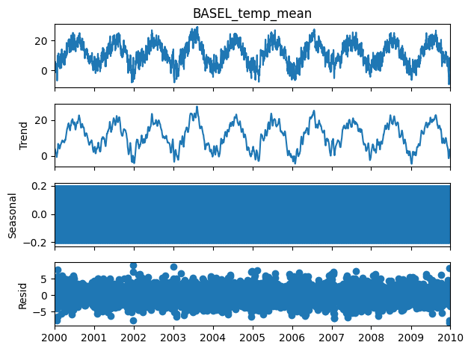
Stationarity Test:
Null Hypothesis (H0): Series is non-stationary
Alternate Hypothesis (HA): Series is stationary
p-value >0.05 Fail to reject (H0)
p-value <= 0.05 Accept (H1)
ADF Test p-value: 0.0003 The data is likely seasonal (reject null hypothesis of non-stationarity).

Slide 10
Train_data:Test_data=80:20
Model Fitting…

Slide 11


Linear Regression:
y=c*x+m
Auto Regression
Moving Average:​​

Slide 12
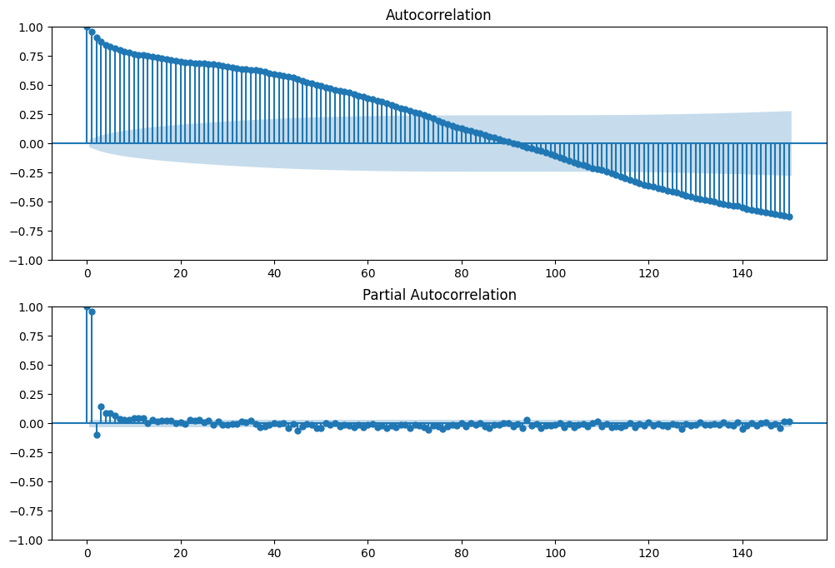
q value:
p value:

Slide 13
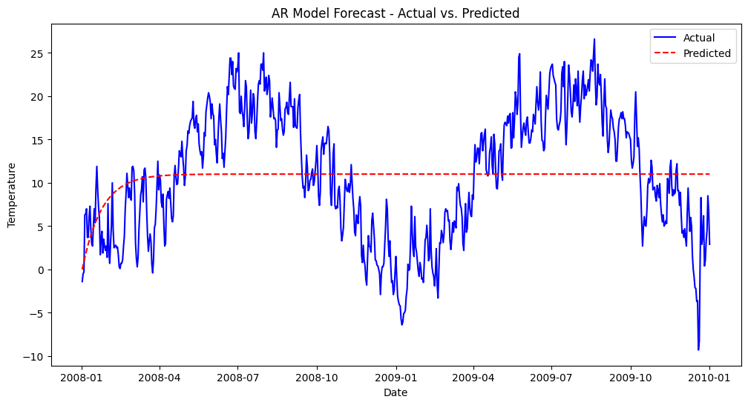
Using AR-1 Model
Root Mean Squared Error (RMSE): 7.178030063335058

Slide 14
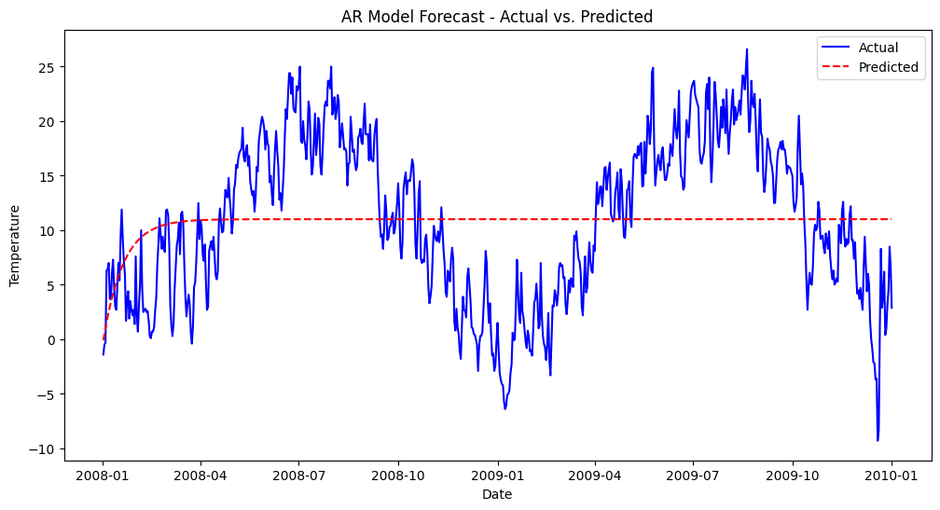
Using AR-2 Model
Root Mean Squared Error (RMSE): 7.202952502548494

Slide 15
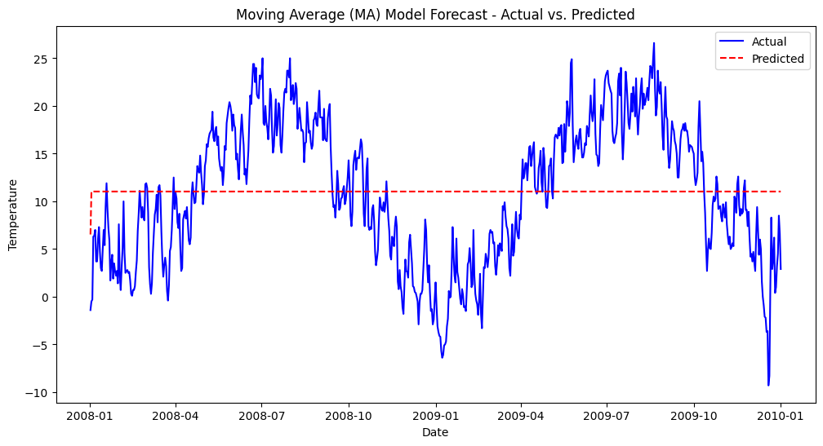
Using MA-1 Model
Root Mean Squared Error (RMSE): 7.345463029786329

Slide 16
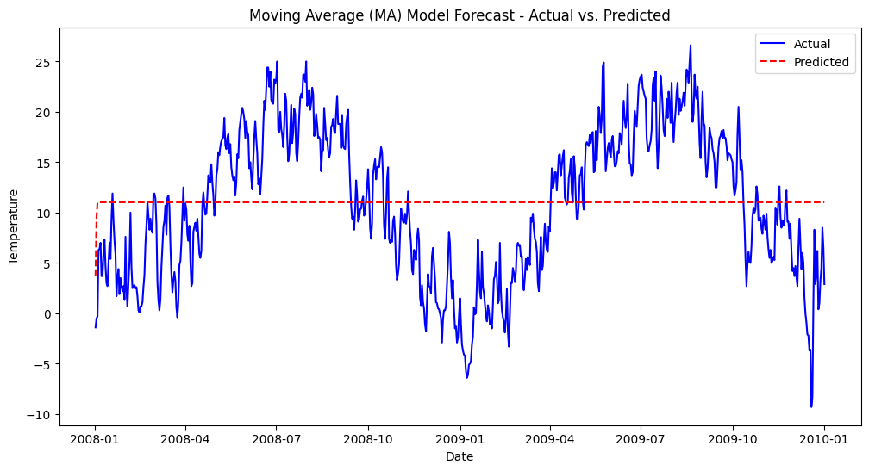
Using MA-2 Model
Root Mean Squared Error (RMSE): 7.339220435828841

Slide 17

Using ARIMA (1,0,1) Model
Root Mean Squared Error (RMSE): 7.208891560880292

Slide 18

Using ARIMA (2,0,1) Model
Root Mean Squared Error (RMSE): 7.203606288217757

Slide 19

Using ARIMA (1,0,2) Model
Root Mean Squared Error (RMSE): 7.172187575199966

Slide 20
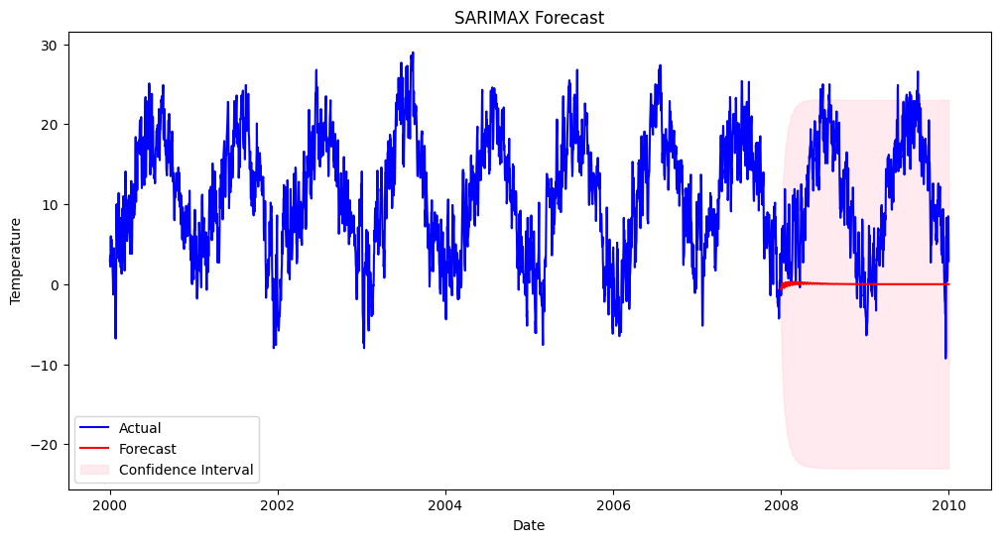
Using SARIMAX (1,0,1,12) Model
Root Mean Squared Error (RMSE): 13.20

Slide 21
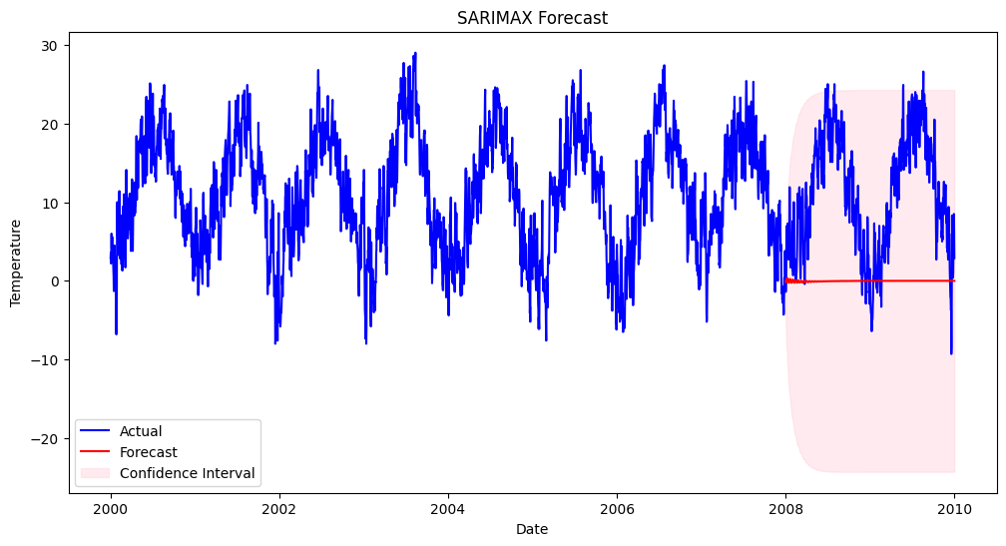
Using SARIMAX (1,0,2,12) Model
Root Mean Squared Error (RMSE): 13.24

Slide 22
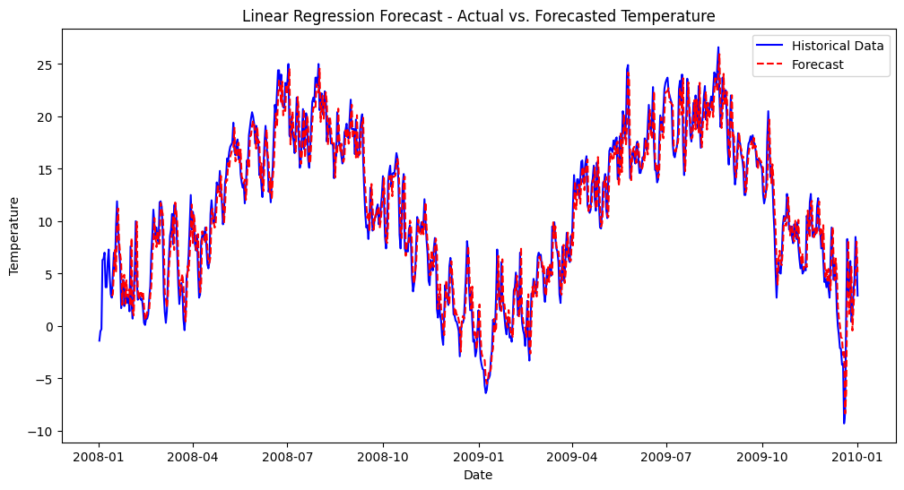
Using Linear Regression
Root Mean Squared Error (RMSE): 2.03

Slide 23
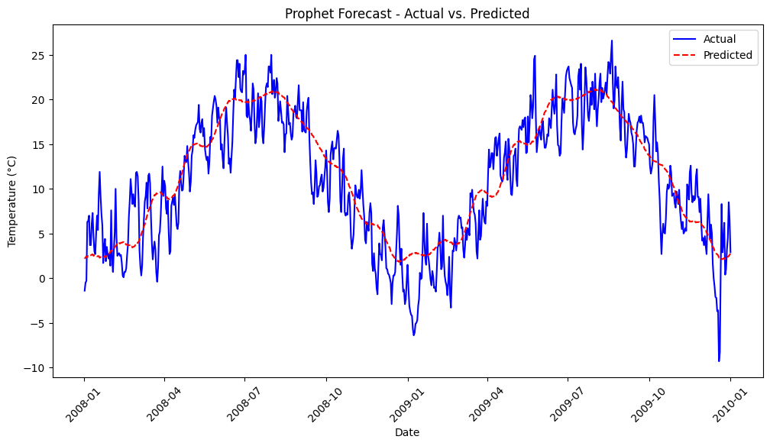
Using Facebook Prophet
Root Mean Squared Error (RMSE): 3.44009023450908

Slide 24
S.No. | Model | RMSE | %Error (Mean=11)
1 | AR1,AR2 | 7.178,7.2 | ~65%
2 | MA1,MA2 | 7.3454,7.339 | ~66.7%
3 | ARIMA(1,0,1) | 7.208 | ~65.5%
4 | ARIMA(2,0,1) | 7.203 | ~65.48%
5 | ARIMA(1,0,2) | 7.17 | ~65.18%
6 | SARIMA(1,0,1,12) | 13.2 | ~120%
7 | SARIMA(1,0,2,12) | 13.24 | ~120%
8 | Linear Regression | 2.03 | ~18%
9 | Facebook Prophet | 3.44 | ~31%

Slide 25
References:
https://www.analyticsvidhya.com/blog/2021/10/a-comprehensive-guide-to-time-series-analysis/
YouTube videos :Time series forecasting by Krish Naik

